Slide 1

RUNGTA COLLEGE OF DENTAL SCIENCES & RESEARCH
MANAGEMENT OF DEVELOPMENTALLY DISABLED CHILDREN
DEPARTMENT OF PEDODONTICS AND PREVENTIVE DENTISTRY

Slide 2
SPECIFIC LEARNING OBJECTIVES
Core areas | Domain
Introduction Attitudes regarding disabled child Role of dental assistant | Cerebral palsy Childhood autism

Slide 3
CATEGORY
MUST TO KNOW
NICE TO KNOW
Barriers in providing care for disabled children
DESIRE TO KNOW
Visual impairement
Classification
Role of dental assistant
Hearing losss

Slide 4
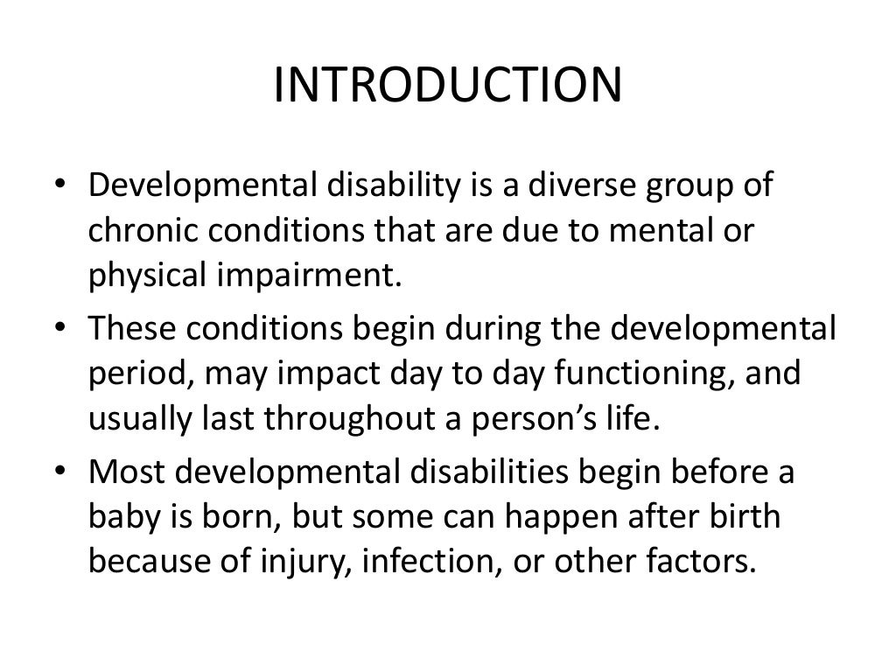

Slide 5
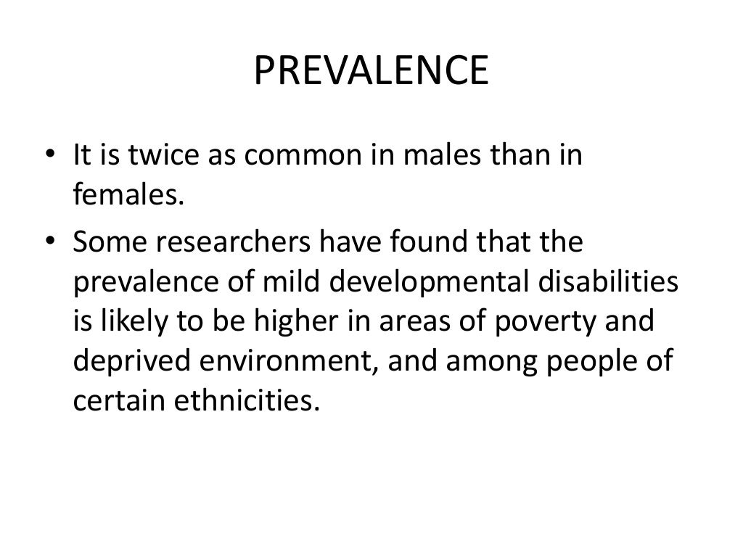

Slide 6
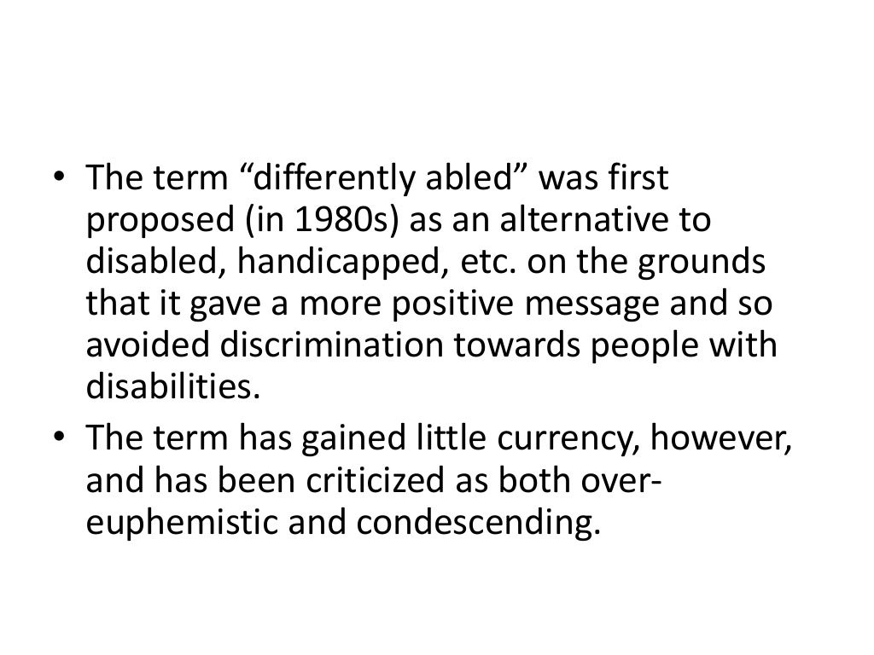

Slide 7
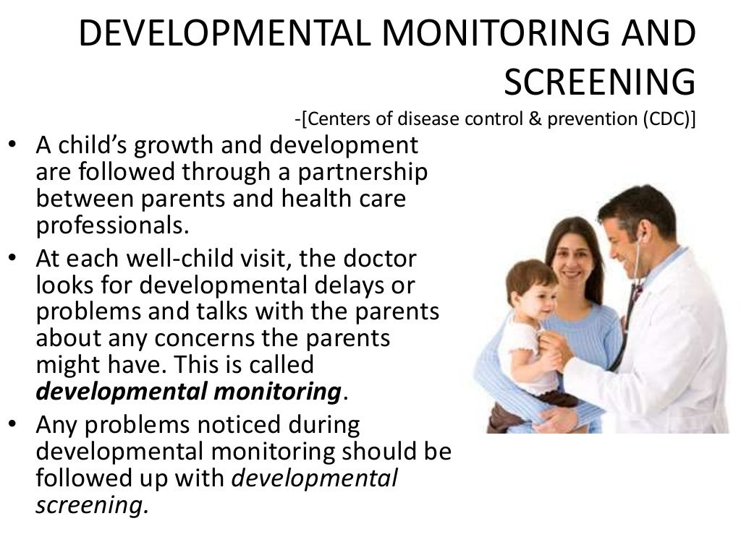

Slide 8
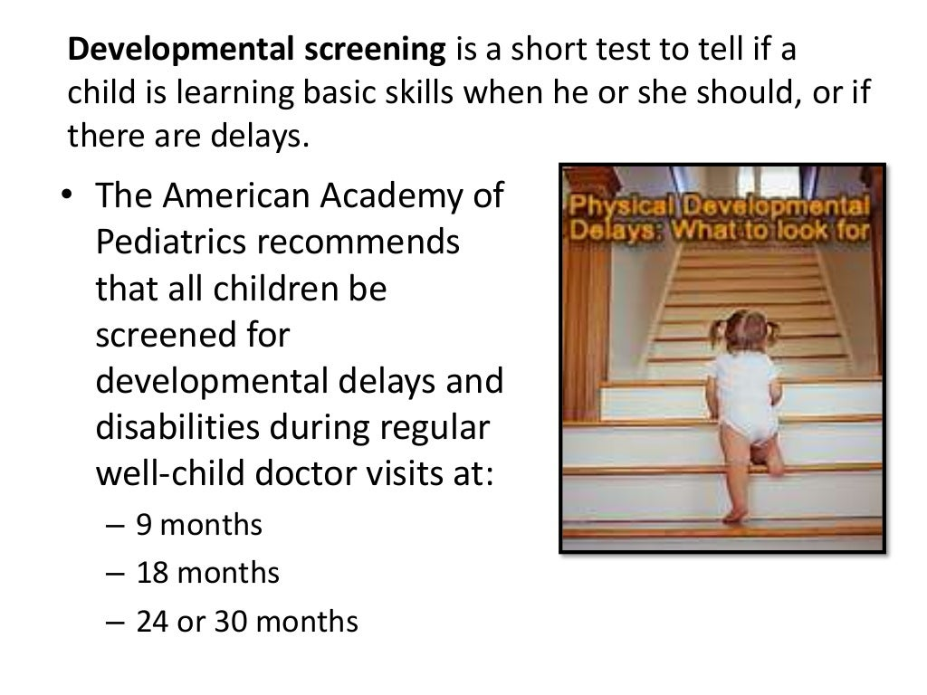

Slide 9
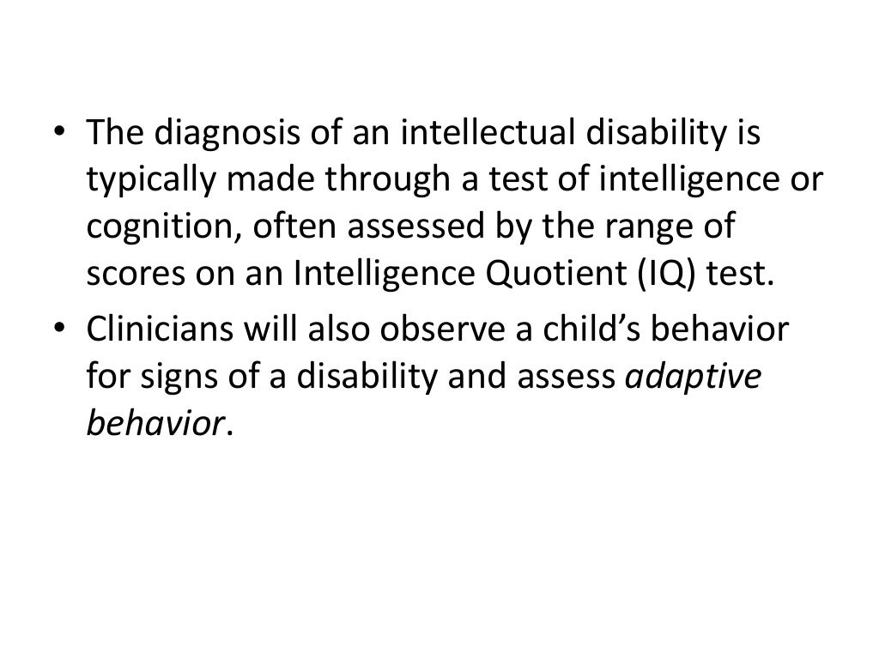

Slide 10
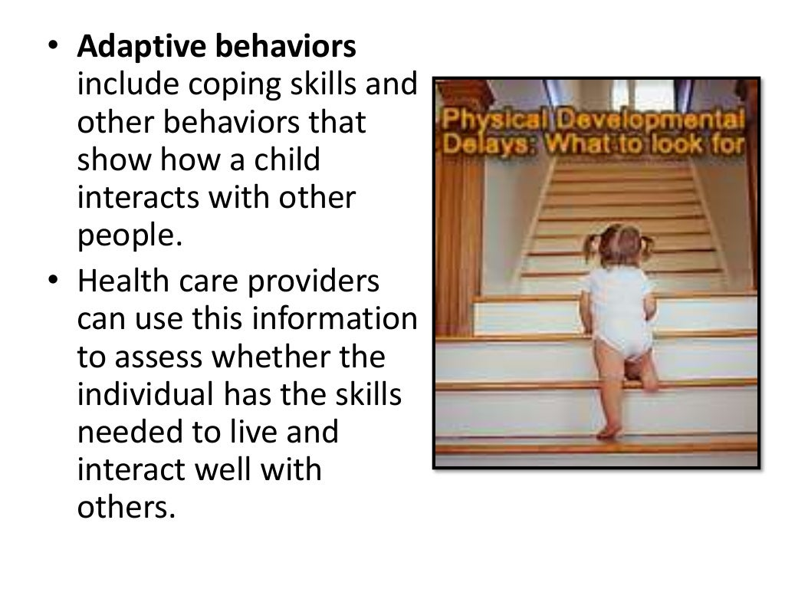

Slide 11
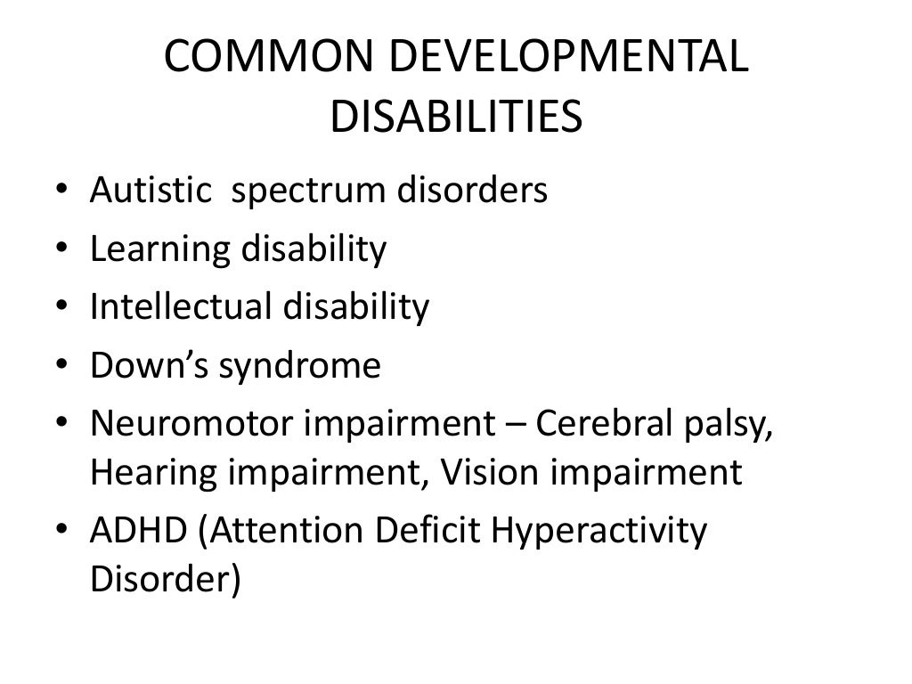

Slide 12
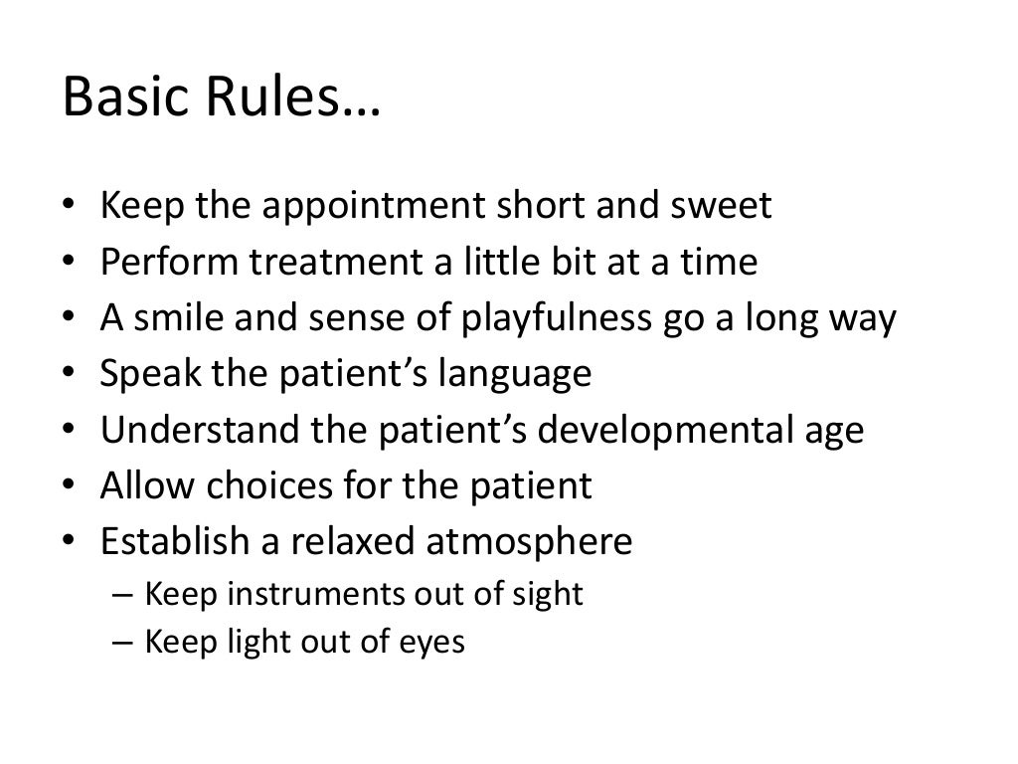

Slide 13


Slide 14
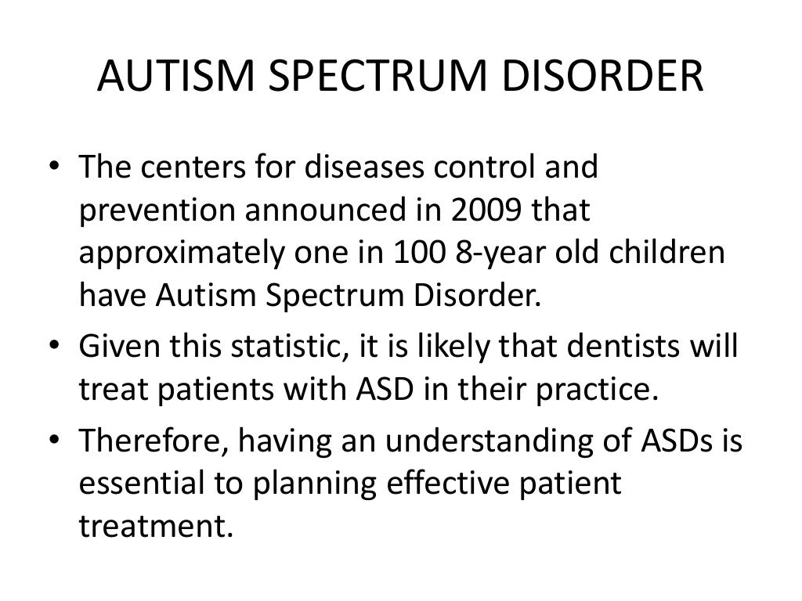

Slide 15
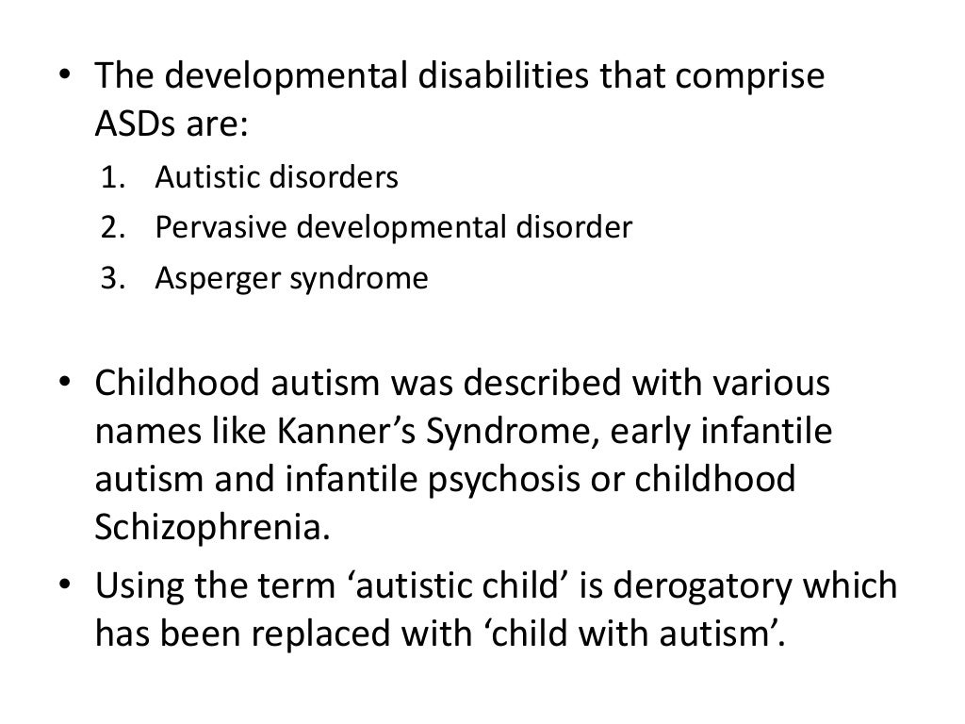

Slide 16
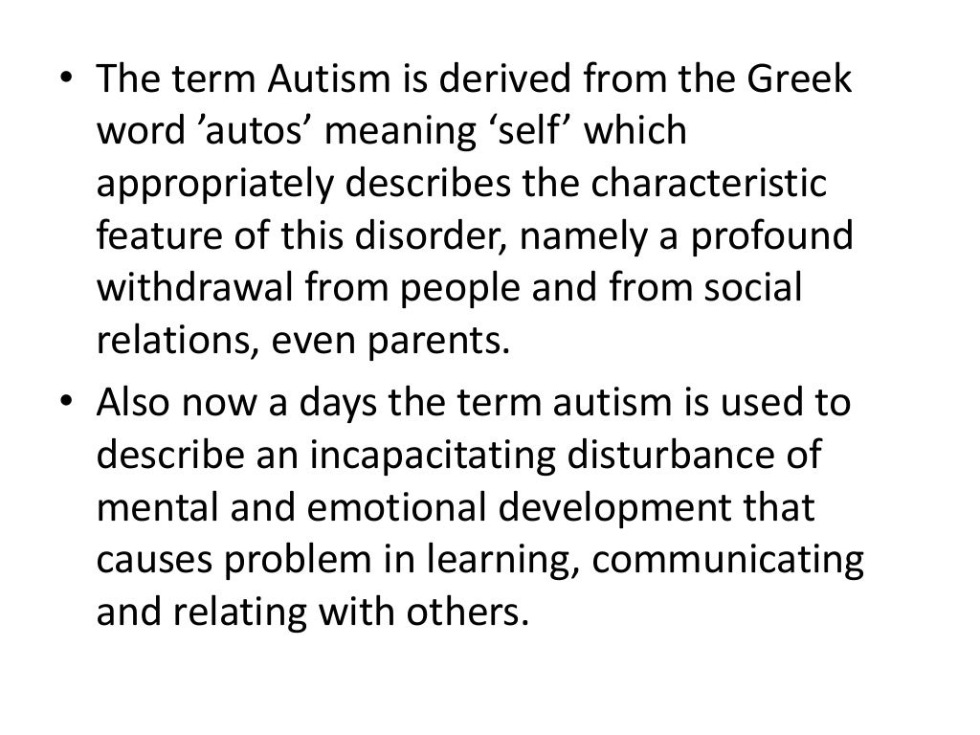

Slide 17
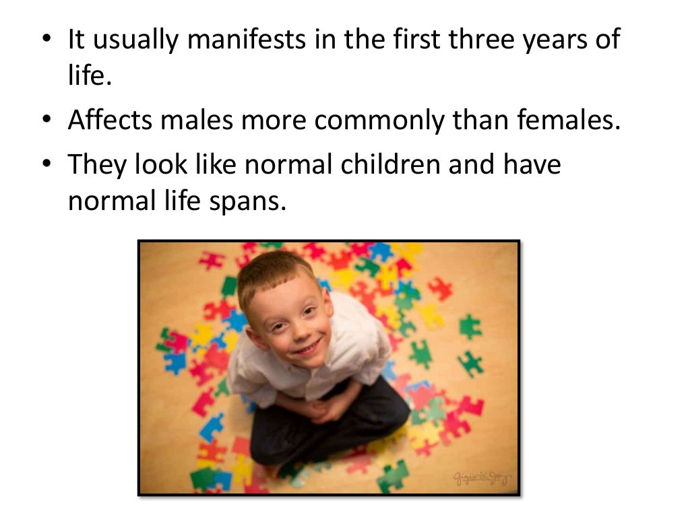

Slide 18
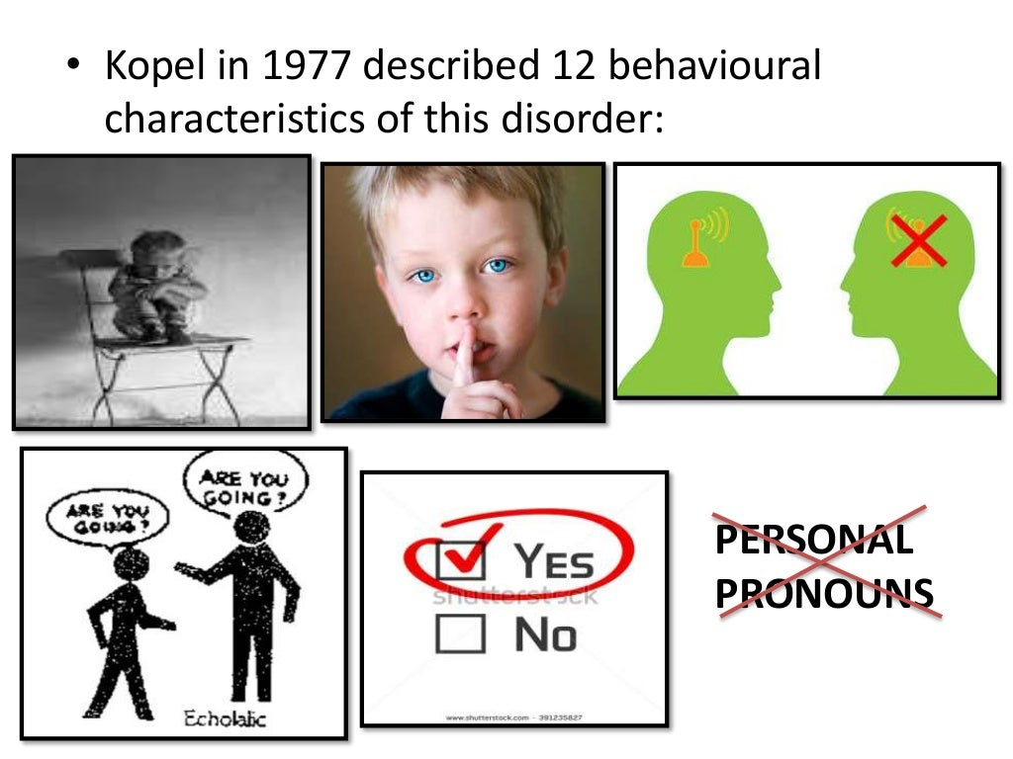

Slide 19
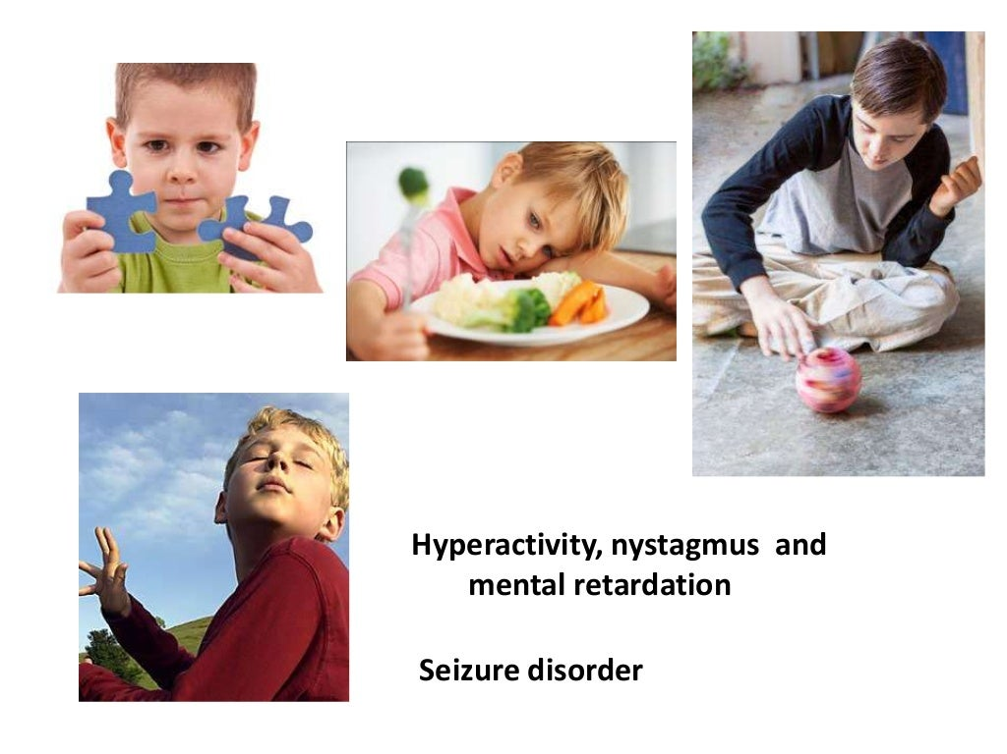

Slide 20
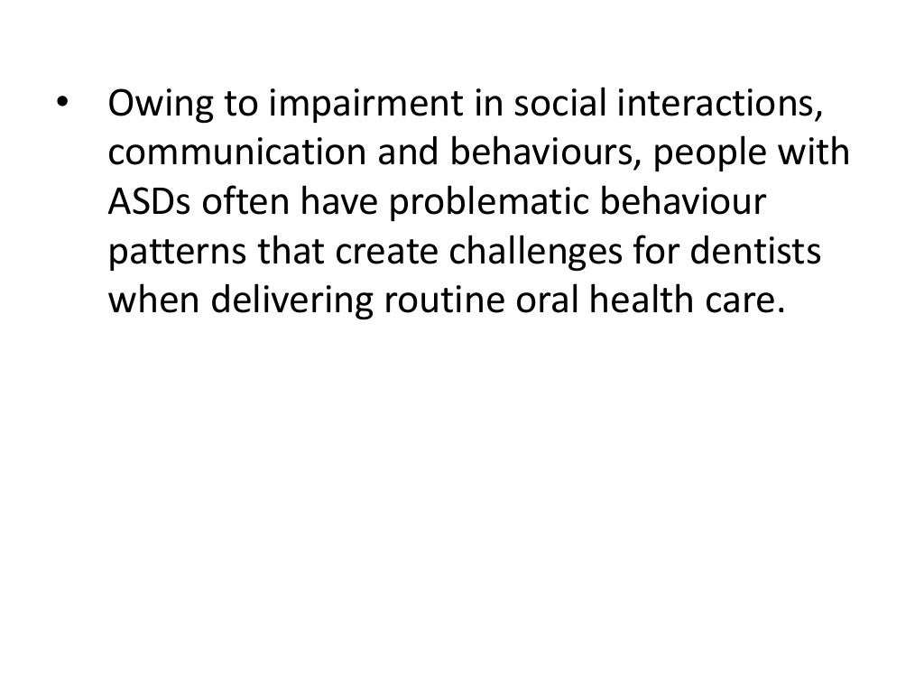

Slide 21
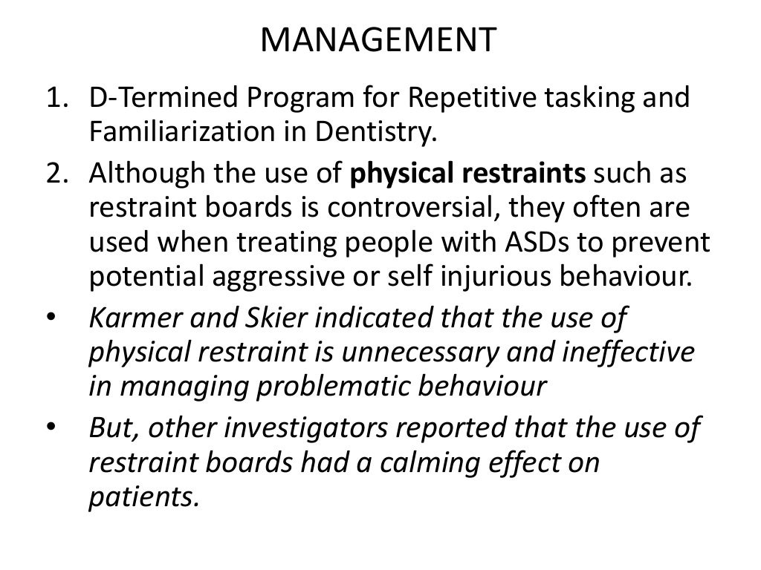

Slide 22
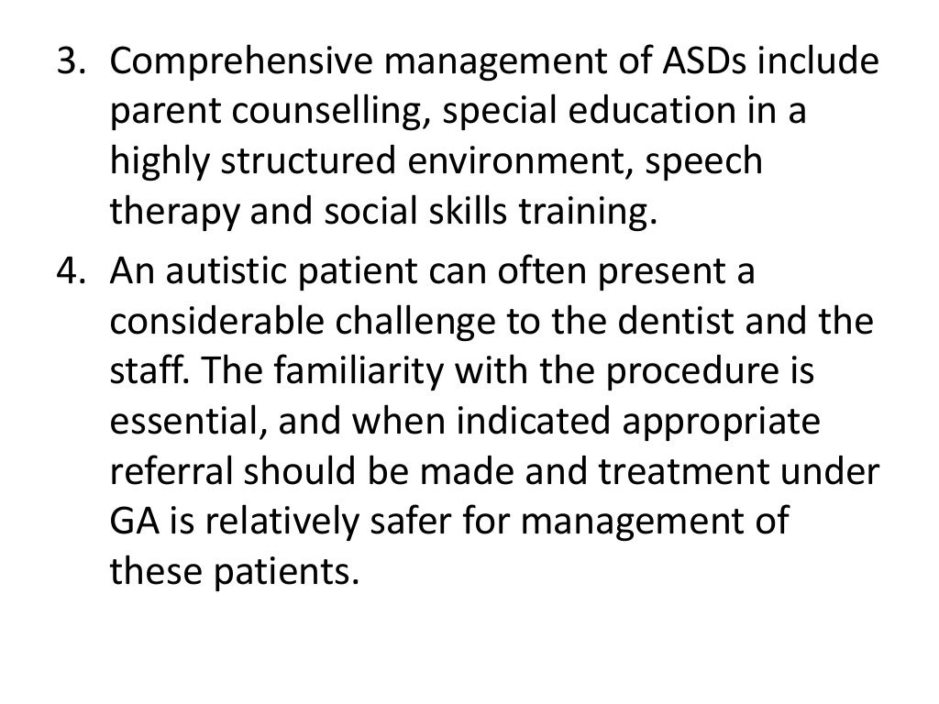

Slide 23
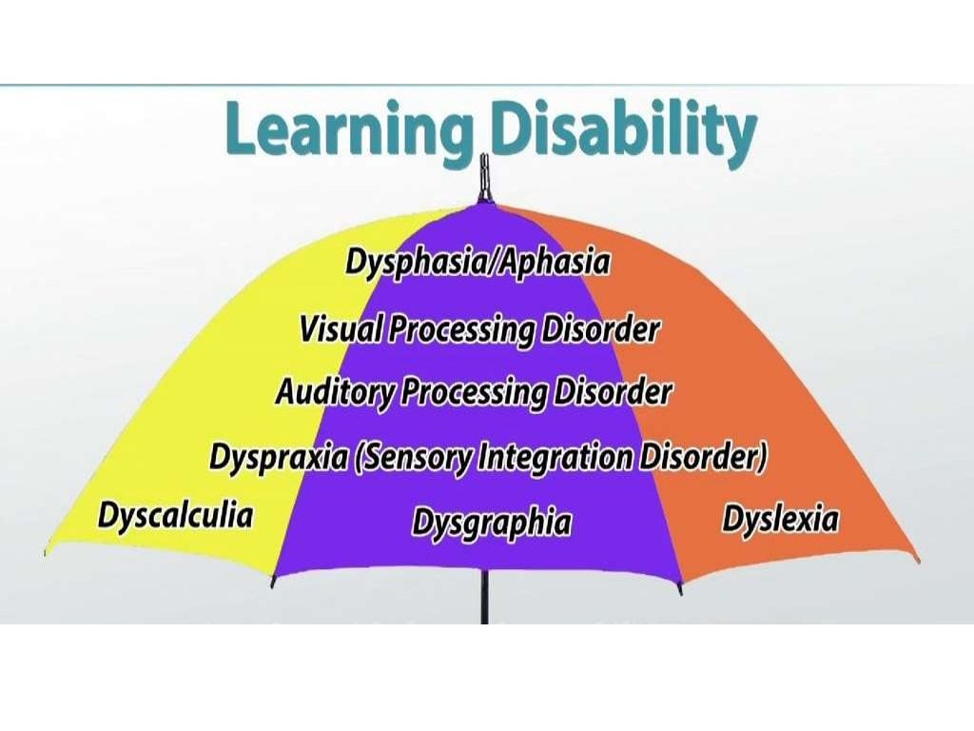

Slide 24
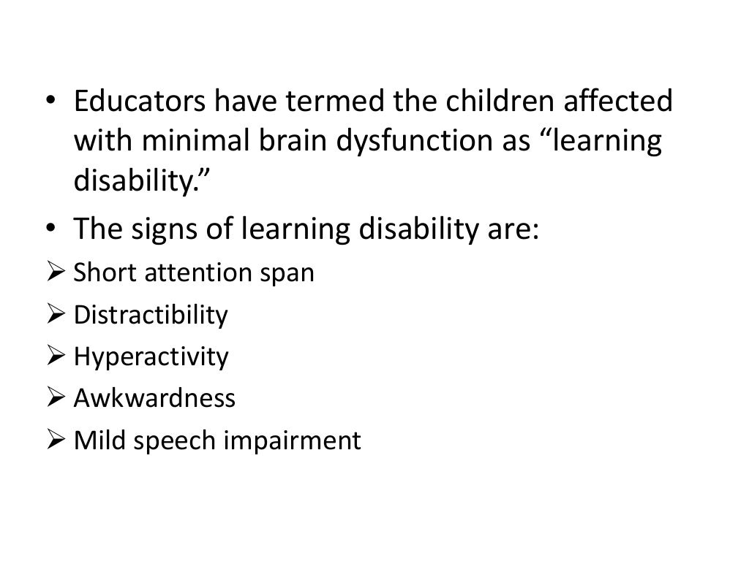

Slide 25
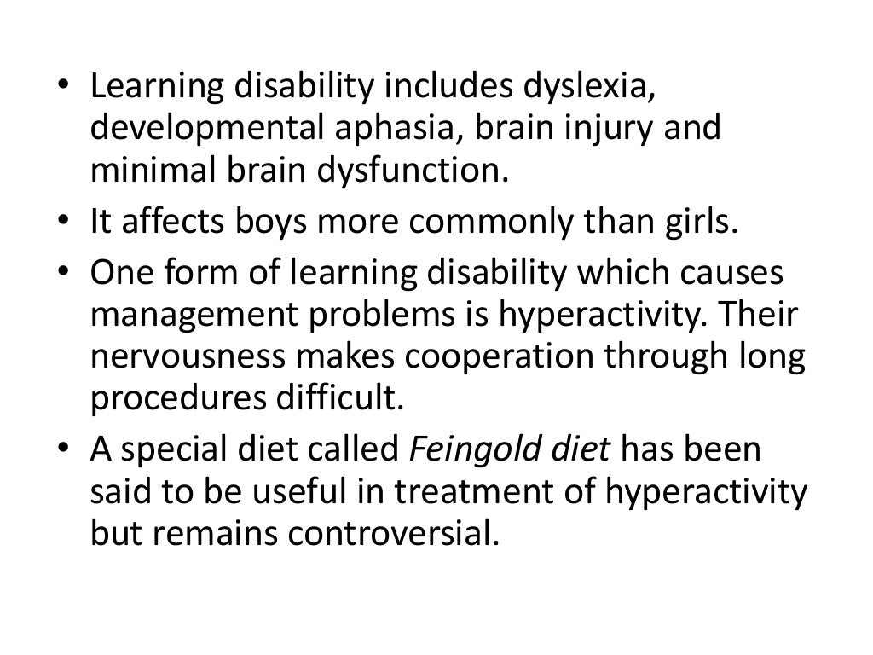

Slide 26
